Slide 1
Bronx Community Health Dashboard:
Mental Health
Last Updated: 5/20/2019
See last slide for more information about this project.

Slide 2
All together, mental disorders, substance abuse and self-harm & interpersonal violence account for 17% of disability in the US
$248
billion
Annual cost of depression in the United States (in 2018 dollars)
Source: Greenberg et al., J Clin Psychiatry, 2015.
Data source: Global Burden of Disease Project, 2017. DALY stands for disability adjusted life year and is a summary measure of population health status that combines data on mortality and morbidity.

Slide 3
Current Depression

Slide 4
The Bronx has the highest prevalence of estimated depression and within the Bronx, females, Hispanic and younger (18-24) residents have the highest prevalence
Bronx only
Data source: New York City Community Health Survey, 2017. Age results are not age-adjusted. *Estimates are unreliable and should be interpreted with caution. Estimated current depression defined as PHQ-9 score≥10.

Slide 5
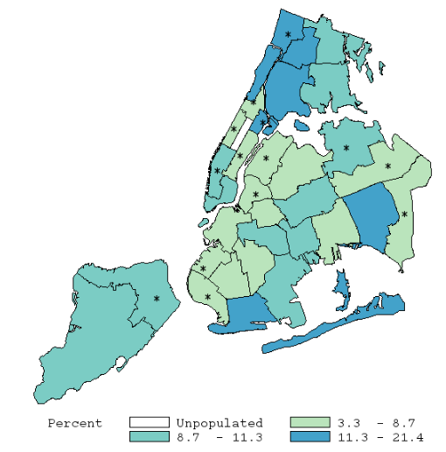
Bronx neighborhood with the highest prevalence of estimated depression is South Bronx
101
103
102
101 | Kingsbridge
102 | NE Bronx
103 | Fordham-Bronx Pk
104 | Pelham-Throgs Neck
105/106/107 | South Bronx
105
106
107
104
Data source: New York City Community Health Survey, 2017
*Estimates are unreliable and should be interpreted with caution.
Estimated current depression defined as PHQ-9 score≥10.

Slide 6
Serious psychological distress
Serious psychological distress is determined by responses to six questions regarding feeling sad, nervous, restless, hopeless, that everything is an effort and worthless. This tool is called the Kessler 6 inventory.

Slide 7
Both the Bronx and the rest of NYC have experienced a decline in the prevalence of serious psychological distress
Serious psychological distress does not reflect a specific symptomology, but is useful for understanding trends
Data source: New York City Community Health Survey, 2002-2015.

Slide 8
Access to mental health services

Slide 9
Among Bronx adults, Hispanic residents that are depressed are least likely to have received mental health counseling or treatment
Bronx only
Data source: New York City Community Health Survey, 2017.
Age results are not age-adjusted.
*Estimates are unreliable and should be interpreted with caution.

Slide 10
Among Bronx youth, female and older youth are more likely to report receiving counseling in the past 12 months
Bronx only
Data source: Youth Risk Behavior Survey, 2017

Slide 11
In the Bronx, the percent of youth receiving professional help for a personal problem in the past 12 months has been relatively stable since 2013
Data source: Youth Risk Behavior Survey, 2013, 2015, 2017

Slide 12
Psychiatric hospitalizations

Slide 13
Bronx has the highest rate of psychiatric hospitalizations
Data source: New York State SPARCS data, 2015 reported in the NYC Community Health Profiles, 2018.

Slide 14
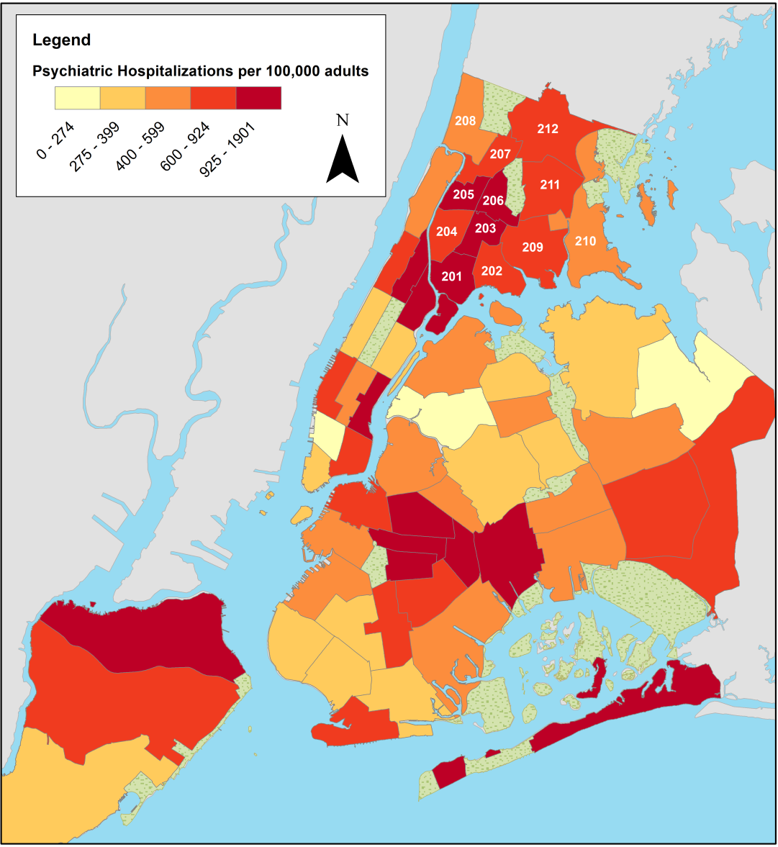
In the Bronx, Morrisania and Crotona has the highest rate of psychiatric hospitalizations
201 | Mott Haven & Melrose
202 | Hunts Point & Longwood
203 | Morrisania & Crotona
204 | Highbridge & Concourse
205 | Fordham & University Heights
206 | Belmont & East Tremont
207 | Kingsbridge Heights & Bedford
208 | Riverdale & Fieldston
209 | Parkchester & Soundview
210 | Throgs Neck & Co-op City
211 | Morris Park & Bronxdale
212 | Williamsbridge & Baychester
Data source: New York State SPARCS data, 2015 reported in the NYC Community Health Profiles, 2018.

Slide 15
Suicide attempts among youth

Slide 16
The percent of youth attempting suicide has increased by 62% in the Bronx since 2003
Data source: New York City Youth Risk Behavior Survey, 2003-2017.

Slide 17
In the Bronx, suicide attempts are increasing for boys and relatively stable for girls, similar to citywide trends
Data source: New York City Youth Risk Behavior Survey, 1997-2017.
Notes:
Compare to city/national

Slide 18
In the Bronx, suicide attempts have increased the most for non-Hispanic black youth
Data source: New York City Youth Risk Behavior Survey, 1999-2017.

Slide 19
Suicide mortality

Slide 20
For the Bronx and the rest of NYC, the suicide mortality rate has remained stable and much lower than the US overall
Data source: Underlying Cause of Death, 1999-2017.

Slide 21
In the Bronx, males and non-Hispanic whites have the highest mortality rates from suicide
Nationwide, 50% of suicides are firearm-related
Data source: Underlying Cause of Death, 2015-2017. Age specific rates not age-adjusted.

Slide 22
In the Bronx, the mortality rate from suicide remains higher among males
Data source: Underlying Cause of Death, 2000-2017.

Slide 23
In the Bronx, the mortality rate from suicide has remained relatively stable among Hispanic and non-Hispanic black residents, but increased among non-Hispanic white residents
Data source: Underlying Cause of Death, 2000-2017.

Slide 24
Non-Hispanic white males have higher mortality rates from suicide than Hispanic and non-Hispanic black males
Data source: Underlying Cause of Death, 2010-2017. Age specific rates not age-adjusted.
Data unreliable for women 65-74.

Slide 25
The most common mechanism for suicide in the Bronx and the rest of NYC is suffocation, which includes hanging and strangulation
Data source: Underlying Cause of Death, 2013-2017. Other includes, for example, cut/pierce, fire/flame, hot object/substance, motor vehicle traffic, machinery, other transport, etc.

Slide 26
Among New York State counties, the Bronx has the second lowest suicide mortality rate
Data source: Underlying Cause of Death from CDC Wonder, 2012-2017.
Schuyler and Yates counties excluded because of unreliable estimates.

Slide 27
About the Community Health Dashboard Project
The goal of the project is to provide Bronx-specific data on risk factors and health outcomes with an emphasis on presenting data on trends, socio-demographic differences (e.g., by age, sex, race/ethnicity, etc.) and sub-county/neighborhood level data
Will be periodically updated as new data becomes available.
Produced by Montefiore’s Office of Community & Population Health using publicly-available data sources
For more information please contact us at OCPHDept@montefiore.org

