Slide 1
Bronx Community Health Dashboard: Asthma Last Updated: 9/24/2019 See end of presentation for more information about this project and links to data sources.

Slide 2
Asthma is the 2nd leading cause of disability in the US among children 5-14y
Disability-Adjusted Life Years (DALYs) are calculated by adding the Years of Life Lost due to premature mortality in the population and the Years Lost due to disability for people living with the health condition or its consequences.
Data source: Global Burden of Disease Project, 2017.
Notes:
UPDATED

Slide 3
Child & adolescent asthma
Lifetime prevalence | Current asthma | Asthma severity | Asthma ED visits | Asthma hospitalizations

Slide 4
The Bronx has the highest percentage of children 0-12 years old who have ever been diagnosed with asthma; within the Bronx, asthma is more common among boys
Bronx only
Data source: New York City Child Health, Emotional Wellness and Development Survey, 2015

Slide 5
The Bronx has the second highest percentage of children 0-12 years old currently with asthma; within the Bronx, current asthma is higher among boys
Bronx only
Data source: New York City Child Health, Emotional Wellness and Development Survey, 2015
Data suppressed for Staten Island

Slide 6
The Bronx has the highest percentage of teens who have ever been diagnosed with asthma; within the Bronx, asthma is higher among boys
Bronx only
Data source: New York City Youth Risk Behavior Survey, 2017

Slide 7
Asthma rates among public school children aged 5-14 years old have increased in all 5 NYC boroughs and remain highest in the Bronx
Rates are calculated by residence of the child. Use of a denominator consisting of all 5-14 year olds results in an underestimate of the true asthma prevalence, since the numerator represents only children enrolled in public schools that report to NYC DOHMH.
Data source: New York City Automated School Health Records (2010-2014), data from New York City DOHMH
Environment & Health Data Portal

Slide 8
Persistent asthma rates among public school children aged 5-14 years old have increased in all 5 NYC boroughs and remain highest in the Bronx
Rates are calculated by residence of the child. Use of a denominator consisting of all 5-14 year olds results in an underestimate of the true asthma prevalence, since the numerator represents only children enrolled in public schools that report to NYC DOHMH.
Data source: New York City Automated School Health Records (2010-2014), data from New York City DOHMH
Environment & Health Data Portal
Notes:
No new data

Slide 9
Asthma-related ED visit rates among children up to 4 years old have remained stable in the Bronx, but declined in all other NYC boroughs
Data source: SPARCS Hospital Discharge Data (2005-2016), data from New York City DOHMH Environment & Health Data Portal
An ED visit is included if it has an ICD-9 principal diagnosis code of 493.
Notes:
UPDATED

Slide 10
The asthma-related ED visit rate among children 5 to 17 years old has increased by 45% in the Bronx
Data source: SPARCS Hospital Discharge Data (2005-2016), data from New York City DOHMH Environment & Health Data Portal
An ED visit is included if it has an ICD-9 principal diagnosis code of 493.
Notes:
UPDATED

Slide 11
Asthma-related hospitalization rates among children up to 4 years old have declined in all 5 NYC boroughs; and remain highest in the Bronx
Data source: SPARCS Hospital Discharge Data (2003-2016), data from New York City DOHMH Environment & Health Data Portal
A hospitalization is included if it has an ICD-9 principal diagnosis code of 493.
Notes:
UPDATED

Slide 12
Asthma-related hospitalization rates among children 5 to 17 years old remain highest in the Bronx
Data source: SPARCS Hospital Discharge Data (2004-2016), data from New York City DOHMH Environment & Health Data Portal
A hospitalization is included if it has an ICD-9 principal diagnosis code of 493.
Notes:
UPDATED

Slide 13
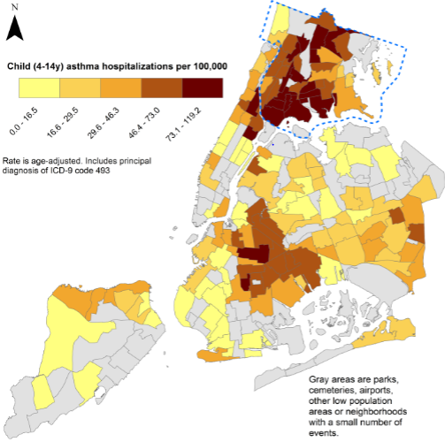
The Bronx has the highest child asthma hospitalization rates in NYC
The highest rates are in these Bronx Neighborhoods
Mott Haven-Port Morris
Claremont-Bathgate
East Tremont
Bedford Park-Fordham North
Hunts Point
Bronxdale
Data source: SPARCS Hospital Discharge Data (2014), data from New York City Neighborhood Health Atlas

Slide 14
Adult asthma
Lifetime prevalence | Current asthma | Asthma ED visits | Asthma hospitalizations

Slide 15
The percent of adults in the Bronx who have ever been diagnosed with asthma has remained relatively stable
Data source: New York City Community Health Survey, 2002-2017.
Data missing for 2005 and 2015.
Notes:
UPDATED

Slide 16
In the Bronx, the percent of adults ever diagnosed with asthma is highest amongst those who are 45-64y, female, or Hispanic
There were no clear trends by education or income among adults.
Data source: New York City Community Health Survey, 2017.
Age group data are not age-adjusted.
Notes:
UPDATED

Slide 17
The percent of adults currently with asthma has generally been highest in the Bronx, only surpassed by Staten Island in 2014
Data source: New York City Community Health Survey, 2002-2017.
Data missing for 2005 and 2015.
Notes:
UPDATED

Slide 18
In the Bronx, the percent of adults currently with asthma is highest among those who are 45-64y, female, or Hispanic
There were no clear trends by education or income among adults.
Data source: New York City Community Health Survey, 2017.
Age group data are not age-adjusted.
For 18-24 age group, data are suppressed due to imprecise and unreliable estimates.
*Unreliable estimate due to small sample size, interpret with caution.
Notes:
UPDATED

Slide 19
Asthma-related ED visit rates among adults are almost two-times greater than the rest of NYC
Data source: SPARCS Hospital Discharge Data (2005-2014), data from New York City DOHMH Environment & Health Data Portal
An ED visit is included if it has an ICD-9 principal diagnosis code of 493.

Slide 20
Asthma-related hospitalization rates among adults are also considerably higher in the Bronx
Data source: SPARCS Hospital Discharge Data (2003-2014), data from New York City DOHMH Environment & Health Data Portal
A hospitalization is included if it has an ICD-9 principal diagnosis code of 493.
Notes:
UPDATED

Slide 21
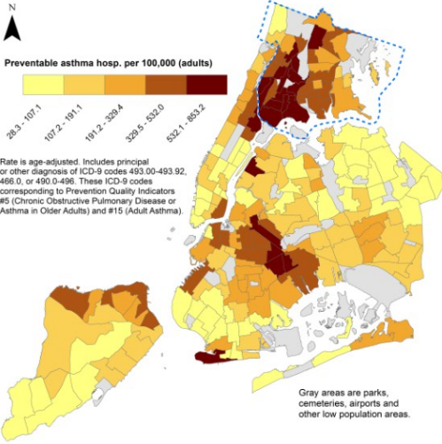
The Bronx and Harlem have the highest rates of preventable asthma hospitalizations among NYC adults
The highest rates are in these Bronx Neighborhoods
Mott Haven-Port Morris
Claremont-Bathgate
Melrose South-Mott Haven North
Longwood
Hunts Point
Data source: SPARCS Hospital Discharge Data (2014), data from New York City Neighborhood Health Atlas

Slide 22
Risk factors
Obesity | Housing quality | Smoking | Air quality

Slide 23
The Bronx has the highest percentage of obese youth compared to all NYC boroughs
Obese is ≥95th percentile for BMI, by age and sex
Data source: New York City Youth Risk Behavior Survey, 2003-2017 (Grades 9-12).
Data captured biennially and not available before 2003.
Notes:
UPDATED

Slide 24
The Bronx has the highest percentage of obese adults of all NYC boroughs
A BMI of ≥30 is classified as obese
Data source: New York City Community Health Survey, 2002-2017.
Body Mass Index (BMI) is calculated based on respondents self-reported weight and height.
Notes:
UPDATED

Slide 25
The percent of homes with mice or rats remains highest in the Bronx
Data source: New York City Housing and Vacancy Survey (1999-2014), data from New York City DOHMH
Environment & Health Data Portal
Notes:
No new data

Slide 26
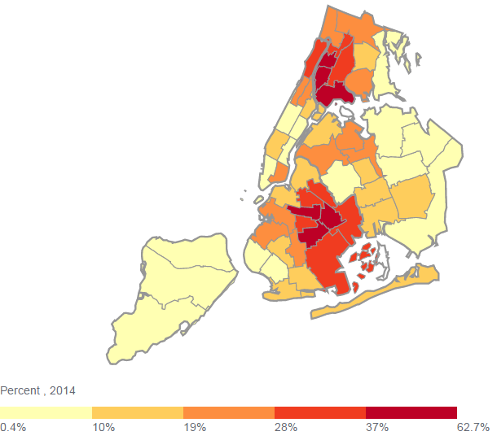
The Bronx neighborhood with the highest percentage of homes with mice or rats in the building is University Heights/Fordham
Highbridge/South Concourse
Kingsbridge Heights/Mosholu
Morrisania/East Tremont
Mott Haven/Hunts Point
Pelham Parkway
Riverdale/Kingsbridge
Soundview/Parkchester
Throgs Neck/Co-op City
University Heights/Fordham
Williamsbridge/Baychester
6
2
10
2
9
5
9
3
103
1
3
8
102
7
4
7
Data source: New York City Housing and Vacancy Survey (2014), data from New York City DOHMH
Environment & Health Data Portal
Notes:
No new data

Slide 27
The percent of homes with cockroaches has decreased in all 5 NYC boroughs since 2008, yet remains highest in the Bronx
Data source: New York City Housing and Vacancy Survey (2008-2014), data from New York City DOHMH
Environment & Health Data Portal
Notes:
No new data

Slide 28
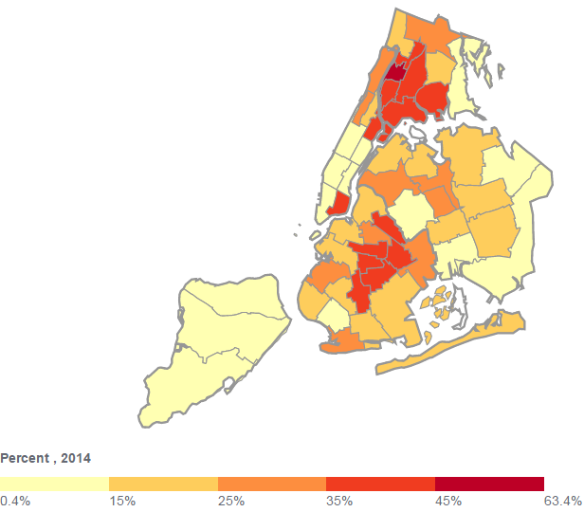
The Bronx neighborhood with the highest percentage of homes with cockroaches is University Heights/Fordham
6
10
Highbridge/South Concourse
Kingsbridge Heights/Mosholu
Morrisania/East Tremont
Mott Haven/Hunts Point
Pelham Parkway
Riverdale/Kingsbridge
Soundview/Parkchester
Throgs Neck/Co-op City
University Heights/Fordham
Williamsbridge/Baychester
101
2
2
9
5
101
103
3
1
3
8
103
7
4
4
Data source: New York City Housing and Vacancy Survey (2014), data from New York City DOHMH
Environment & Health Data Portal
Notes:
No new data

Slide 29
The Bronx has the highest percentage of adults reporting mold in the home
Data source: New York City Community Health Survey (2012), data from New York City DOHMH Environment & Health Data Portal
Notes:
No new data

Slide 30
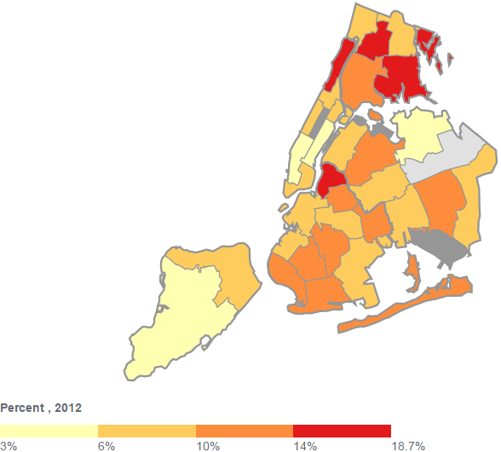
The Bronx neighborhood with the highest percentage of adults reporting mold in the home is Fordham – Bronx Park
2
Fordham – Bronx Pk
Kingsbridge – Riverdale
Northeast Bronx
Pelham – Throgs Neck
South Bronx
1
3
4
9
102
4
5
103
102
4
7
1
104
1
Data source: New York City Community Health Survey (2012), data from New York City DOHMH
Environment & Health Data Portal
Notes:
No new data

Slide 31
The percent of current adult smokers across New York City has fallen since 2002, but remains highest for Staten Island
Data source: Community Health Survey, 2002-2017.
Staten Island 2010 data is likely an underestimate of the true prevalence of smoking due to random sampling variation.
Notes:
UPDATED

Slide 32
Despite having middle of the road smoking rates, the percent of adults reporting second-hand smoke is highest in the Bronx
Data source: New York City Community Health Survey (2004-2012), data from New York City DOHMH
Environment & Health Data Portal
Notes:
No new data

Slide 33
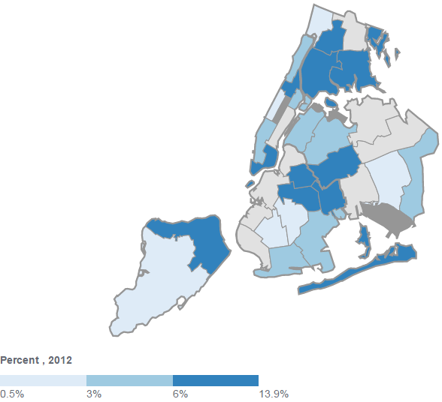
The Bronx neighborhood with the highest percentage of adults reporting second-hand smoke in the home is South Bronx
2
2
4
1
4
1
9
102
4
5
4
5
103
102
4
7
1
104
1
Data source: New York City Community Health Survey (2012), data from New York City DOHMH
Environment & Health Data Portal
Notes:
No new data

Slide 34
Fine particulate concentrations are, on average, second highest in the Bronx, although they have improved across NYC
Data source: New York City Community Air Survey (2009-2017), data from New York City DOHMH
Environment & Health Data Portal
Notes:
UPDATED

Slide 35
Potential risk factors for which there is evidence of an association with asthma, but no data available for the Bronx
Pets (exposure to pet dander exacerbates asthma)
Pollen (exposure to pollen exacerbates asthma)

Slide 36
About the Community Health Dashboard Project
The goal of the project is to provide Bronx-specific data on risk factors and health outcomes with an emphasis on presenting data on trends, socio-demographic differences (e.g., by age, sex, race/ethnicity, etc.) and sub-county/neighborhood level data
Data will be periodically updated as new data becomes available.
Produced by Montefiore’s Office of Community & Population Health using publicly-available data sources
For more information, please contact us at OCPHDept@montefiore.org

Slide 37
Links to data sources
Global Burden of Disease Project: https://vizhub.healthdata.org/gbd-compare/
New York City Child Health, Emotional Wellness and Development Survey: https://a816-healthpsi.nyc.gov/epiquery/Child/CCHSIndex.html
New York City Community Health Survey: https://a816-healthpsi.nyc.gov/epiquery/CHS/CHSXIndex.html
New York City Youth Risk Behavior Survey: https://a816-healthpsi.nyc.gov/epiquery/YRBS/yrbsIndex.html
New York City Environment & Health Data Portal: http://a816-dohbesp.nyc.gov/IndicatorPublic/publictracking.aspx
New York City Neighborhood Health Atlas: https://public.tableau.com/profile/nyc.health#!/vizhome/NewYorkCityNeighborhoodHealthAtlas/Home

